Slide 1
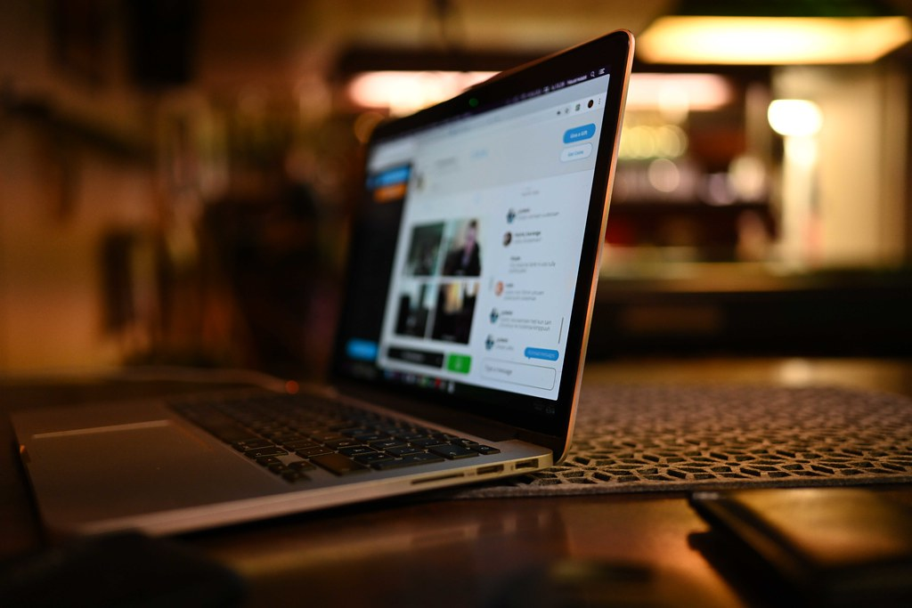

Fr. Conceicao Rodrigues College of Engineering SE-Mini Project Department of Computer Engineering
Under Guidance of: Prof. Kranti Wagle
SE-Computers (Div - B)- Group 6
Shubham Ojha (9276)
Glenn Mendonca(9272)
Glen Rodrigues(9287)
Divyansh Dalmia(9249)

Slide 2
Introduction
In light of the COVID-19 outbreak caused by the novel coronavirus, companies and institutions have instructed their employees to work from home as a precautionary measure to reduce the risk of contagion. Employees, however, have been exposed to different issues because of working from home.
Moreover, the rapid global spread of COVID-19 has increased the volume of data generated from various sources. Working from home depends mainly on web applications that help employees to efficiently accomplish their tasks. For Managers/Teachers/Employees however, keeping track of the meeting agenda, attendance, and all topics spoken about in these virtual meets is often a pain.

Slide 3
Introduction
They must keep track of when participants join and leave, what ideas were given out during the meet, and deadlines among side conversations and distracting sidenotes or segues. Many people complain about the difficulty and cost of getting these tasks done by an individual or an app.
Our Meet summarizer aims to streamline the entire process of taking attendance, creating transcripts, and keeping track of the agenda in a Meet. All the user has to do is enable the meet summarizer app. At the end of the meet, the user may open our application and view all the details about the meet.

Slide 4
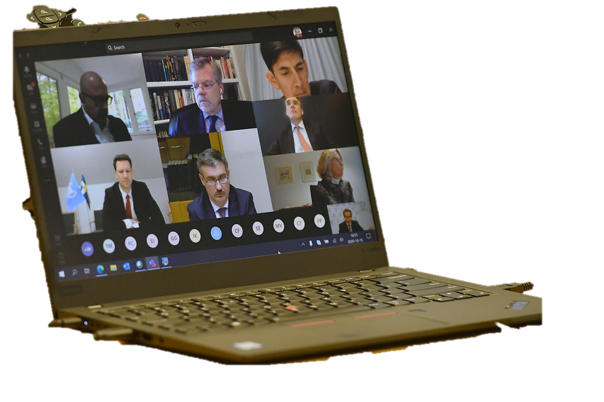
Problem statement
Since the advent of Covid-19, all meetings and discussions have shifted online. It is required by companies and organizations to keep track of all meetings and points of interest.
A person cannot do that easily, whist attending the meeting. Hence a team meetings summarizer is the need of the hour.
This Photo by Unknown Author is licensed under CC BY

Slide 5
Abstract
Since the advent of Covid-19, all meetings and discussions have shifted online, since March of 2020. After a year of online research, majority survey respondents (74%), think that meetings should continue to have at least a virtual component, even after the pandemic ends.
People cite the ease of attending from anywhere in the world as a major perk, although they admit that virtual events haven’t been able to simulate the networking that accompanies the offline ones.
Companies, organizations as well as educational institutions require to keep track of all meetings and points of interest, in the form of minutes of meetings.

Slide 6
Abstract
It would also be beneficial for teachers to derive keen insights out of their online classes, so that they can better analyze how students are understanding on an individual level, based on their responses during meet.
A person may find it difficult to do that whilst attending the meet. Hence, a team meetings summarizer is the need of the hour. We propose to develop a solution by creating a software, using concepts of Machine Learning (ML) and Natural Language Processing (NLP) to convert speech to text. This text will be saved as a transcript, together with the person who said those words.

Slide 7
Abstract
Using ML and NLP, the algorithms will be able to draw and display valuable insights, such as due dates discussed during the meet, individual assignments for each student/personnel and more. The software will also display essential analytics such as words per minute, productivity during the meet and meeting logs. In the end, it will also give a broad overview of the entire meet.
We have a vison to create a streamlined work environment and make lives easier for people at all levels of the company and educational institutes.

Slide 8
Objectives
To create a one-stop application that makes online meetings and logistics more productive and time-saving.
To allow people to gain useful insights, that could be made use of in endless ways.
To generate editable live text from speech, so that no part of the transcript is gibberish or incomprehensible.

Slide 9
Literature Survey
Towards Automatic Minuting of Meetings [1] Introduction to Application
• The paper provides theoretical and descriptive basis for automatic creation of minutes.
This paper contains methods that can be used for dialogue summarization by training done on suitable datasets.
Summary
• The paper lays out foundations for research into automatic minuting of meetings. The main goal is to prepare the floor for automatic minuting by analyzing the sources which help to make this idea realizable.

Slide 10
Literature Survey
By comparing a variety of meeting types, they have tried to get a reasonable typology of meetings, summarized the types of possible minutes, described the meetings, datasets and made a survey of methods of meeting summarization.
• They also have drafted the first steps to the creation of the corpus of meetings and minutes which will be further used for developing automatic minuting.
Research Gap
• This application gives a ton of theoretical knowledge about the various methods of meeting summarization/ classification.
• However, it lacks using the summarized data to further schedule tasks, deadlines or basically to check if desired meeting objective is met.

Slide 11
Literature Survey
Need for Speech-to-Text [2] The use of technology is very important nowadays. Most of everyday activities are documented and stored in digital form. One of those activity is recording. Activity of an organization is very important, therefore recording of meeting material is one of those important activities. Usually the meeting material is documented by writing them into papers or typing them and stored them into computer.
Sometimes, the meeting information is written or typed incorrectly so a speech-to-text application is required to solve this problem. In this study, the solution offered is to implement a web-based automation speech-to-text application which can record the voice of meeting participants then converted them into text automatically, so the results of the recording process of meeting materials are more effective and efficient.

Slide 12
Literature Survey
Human Voice Recognition System [3] This research presents an effective and robust method for extracting features for speech processing. Here, we proposed a new human voice recognition system using the combination of decimated wavelet (DW) and Relative Spectra Algorithm with Linear Predictive coding.
The proposed scheme has performed superior to the existing technique by using the fifty preloaded voice signals from six individuals, the verification tests have been carried and an accuracy rate of approximately 90 % has been achieved.

Slide 13
Literature Survey
Google Chrome Extension for Google Meet [4] In this study, a Chrome extension is used for making the process of transcription hassle-free. It uses the text summarization technique to generate concise and succinct matter. Also, the tool is accessorized using Google Translation, to convert the processed text into users' desired language. This paper illustrates, how captions can be traced from the online meetings, corresponding to which, meeting transcript is sent to the backend where it is summarized using an NLP model.

Slide 14
Literature Survey
Abstractive Summarization with Pegasus[5] In this study, a pipeline for self-supervised pre-training objective for abstractive summarization, gap sentences generation and study strategies for selecting those sentences, is proposed.
In PEGASUS, important sentences are removed/masked from an input document and are generated together as one output sequence from the remaining sentences, similar to an extractive summary.
It is also mentioned, how good abstractive summarization performance can be achieved across broad domains, with very little supervision by fine-tuning the PEGASUS model, with training on as little as 1000 example texts.

Slide 15
Proposed Systems - An analysis
There are two major components to fulfil our task-
Transcript generation & Summarization of generated transcript.
For this, we have brainstormed and researched to find multiple solutions.
Transcript Generation-
Web scraping (extracting information from HTML source elements of Google Meet)
Traditional Speech-To-Text using methods of NLP
Summarization-
Extractive
Abstractive
Using NLU and NLP to understand context of speech and its semantics.*
*Study of meaning that is used to understand human expression through language

Slide 16
Comparison of methods
Web Scraping
Traditional Speech-To-Text using NLP
In this method, Web Scraping from the HTML elements of Google Meet is implemented.
It provides names(Google Username) of every participant as they speak.
Transcript generated is real time
Accuracy of transcript is highly dependent on Google Meet’s Speech Recognition.
Can be used only for Google Meet
In this method, pre-trained speech recognition modules are deployed, using methods of deep learning, where the neural network learns to recognise speech
Providing names of every participant is challenging, as additional permissions will be needed.
For real-time transcript generation, module must be trained extensively, or a pre-trained API can be downloaded
Accuracy is dependent on number of parameters of the algorithm
Can be used for all kinds of meeting software.

Slide 17
Comparison of methods
Extractive Summarization
Involves picking up the most important phrases and lines from the text. Then, combine all important lines to create the summary.
Quick and easy to implement, as it only has to identify and delete unimportant filler words and phrases.
Better option, when in a hurry and a quick glance is needed
Abstractive Summarization
Involves methods of deep learning. Thus, it finds patterns in the text, and forms new phrases and terms, keeping the points and meaning same.
Takes longer to build a model and implement. Model training and fine-tuning also takes time.
Better option, when a new insight is needed, that could’ve gotten missed when using extractive summarization.

Slide 18
Comparison of methods-conclusion
Transcript Generation
Summarization
As of now, we have implemented Web Scraping using Selenium, to extract transcript generated by Google Meet.
In the coming few weeks, we will be implementing a deep-learning based model for traditional speech-to-text using NLP or making use of a pre-defined API, like IBM’s Watson or Google’s Speech To Text.
Using a custom Speech-to-Text, will allow us to not be limited to only Google Meet. However, distinguishing every individual’s voice during transcription will be a challenging task.
For Summarization, as mentioned in the previous slide, each of the two types have their own merits and demerits.
However, we are yet to decide which of the two to implement in our application.
While extractive is easier to implement, it provides a rather rudimentary summary of the input transcript.
Meanwhile, abstractive summarization of text is still an active field of research and is rather difficult.

Slide 19
Software to be used
GPT2- by OpenAI (Google) for summarization
Python-nltk for Natural Language Processing for summarization
Python-tkinter library for building the User-Interface
Selenium for web automation
BeautifulSoup python library for parsing HTML

Slide 20
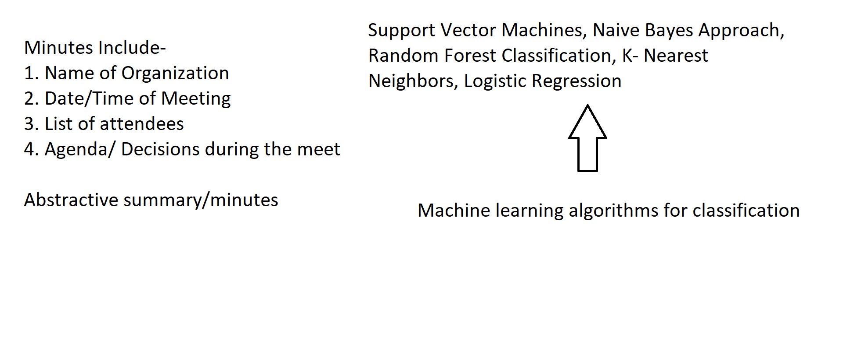
Architecture

Slide 21
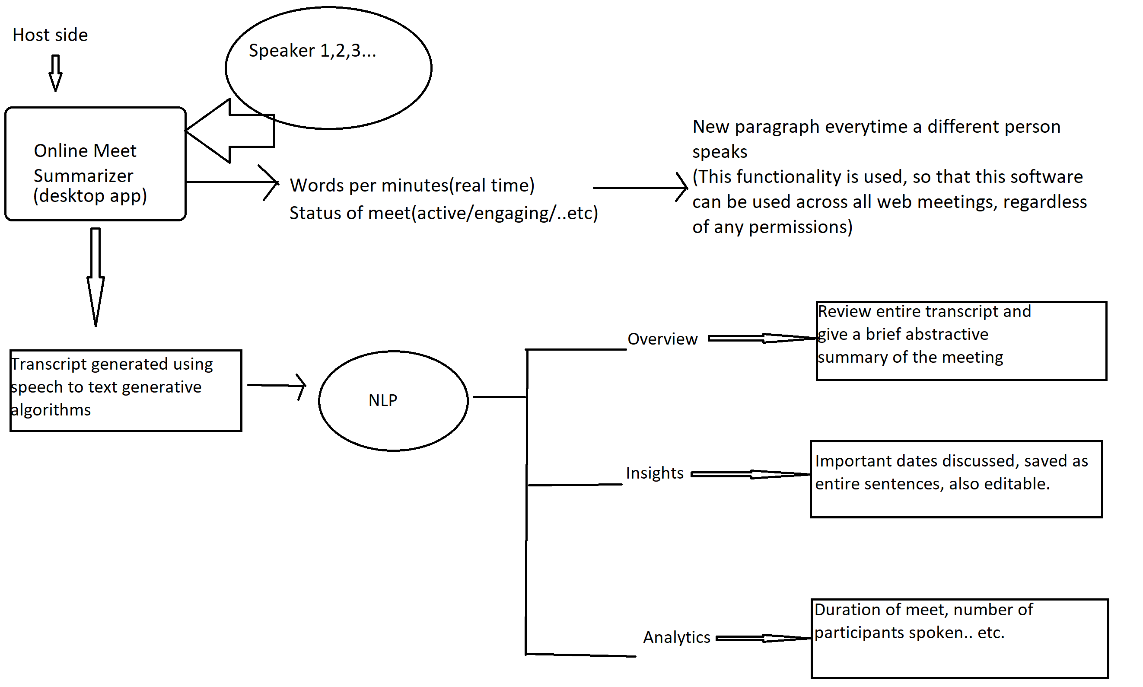
Architecture

Slide 22
Challenges faced
While generating transcript for online meetings wasn’t that challenging, on extensive research and studying NLP deeply we found that the task of generating a summary of a conversation is a significantly difficult and challenging task, still a problem with active research by top tech firms.
More so, generative abstractive summaries after going through the transcript is even more challenging than extractive summarization. The reason for the same is that, abstractive summarization tries to digest the entire transcript, pay attention to important topics discussed and generates new text from it understands contextually. There has been some success in the fields of summarizing articles, but conversations bring a whole different aspect with them.
Some methodologies we implemented for summarization-
Extractive Summarization-
Removing stop words using built-in list from python-nltk
Extending the above, by creating a context-based graph between words complementing/supporting each other in a sentence.
Abstractive Summarization-
Recurrent Neural Networks using TensorFlow
Transformers & Auto Encoders like BERT(Bidirectional Encoder Representations) & GPT-2(Generative Pretrained Transformer)

Slide 23


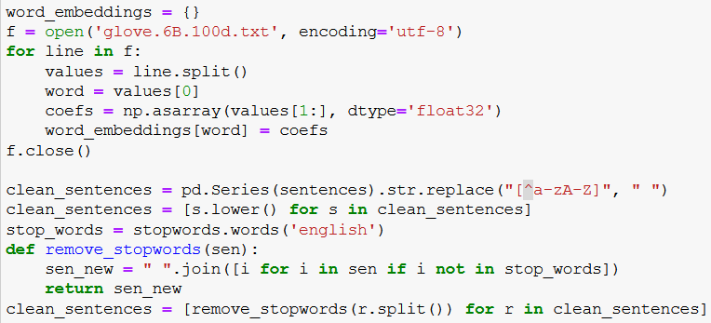
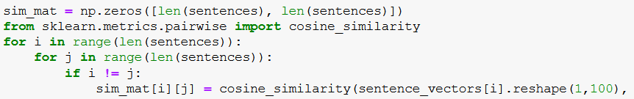
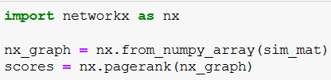
Extractive Summarization
Python-nltk
Nltk + similarity matrix

Slide 24
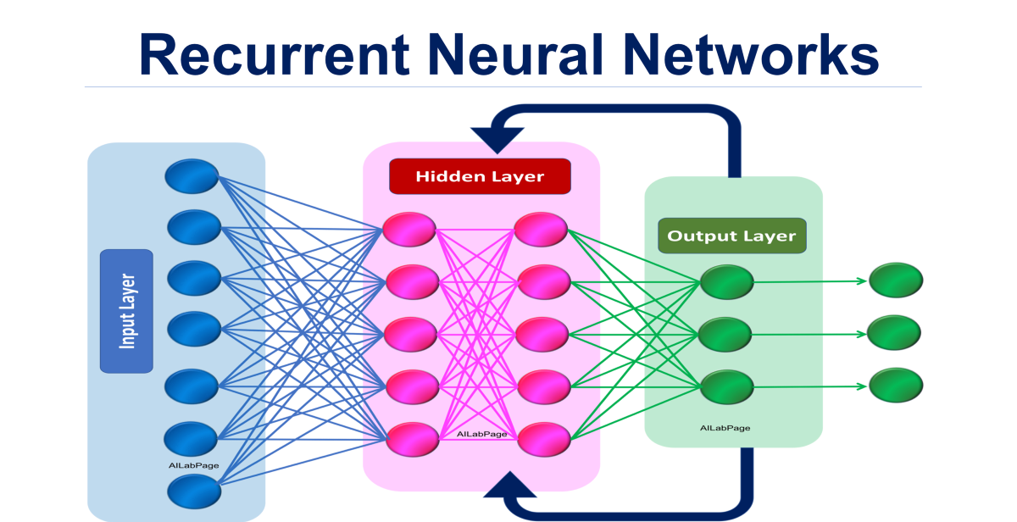
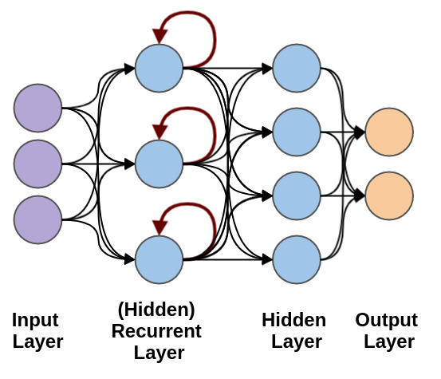
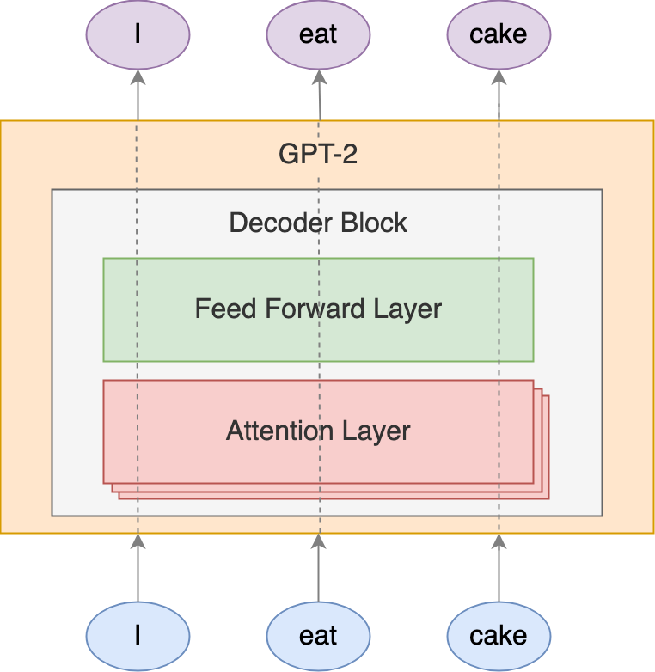
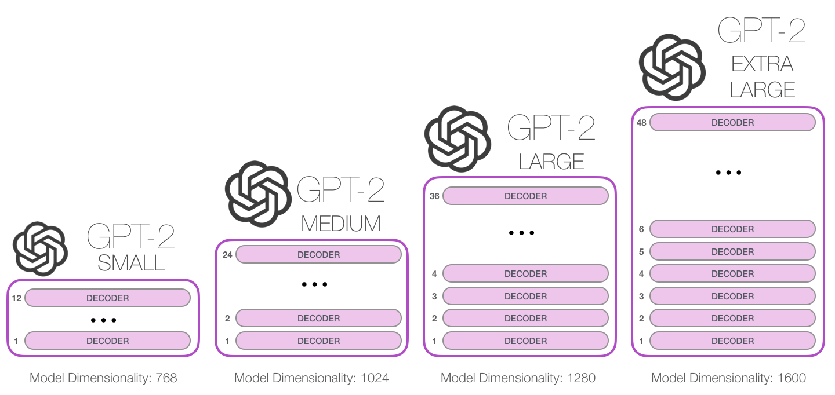
Abstractive Summarization

Slide 25
Tkinter
Selenium
Beautiful Soup
Splash
Initial
Scrapper
App
Login
Meet Setup
Main
Enter Meet
Initial
Start Captions
Start
Extract Captions
Further Transcript Summarization
Stop
Update Functions ...

Slide 26
Societal Impact
Help working professionals/students extract the maximum out of meetings, both professional and unprofessional i.e. a brainstorming session with peers, or an agenda-based meeting.
Enable everyone using this software, to take maximum advantage of various analytics, insights and overview of the entire meeting, so as to enhance their productivity with every subsequent meeting.

Slide 27
Conclusion
In conclusion, our application does better than the other competitions, uses the meet interface to its full potential and will be platform independent in the future. We have written the entire app in python which contributes to its quick and snappy functioning. Our app can successfully join your google meet and constantly record the words spoken.
It then compiles the speech along with the user who said it to a textbox which can be copied and saved to a file. Going forward in the next semester, we will add more functionality to our app and enable it to summarize the text using Natural language processing. We hope to save the time and effort by automating the process of creating a transcript and summarizing it.

Slide 28
References
RESEARCH PAPERS
https://api.semanticscholar.org/CorpusID:204861059
https://www.researchgate.net/publication/335660514_Web-Based_Automation_Speech-to-Text_Application_using_Audio_Recording_for_Meeting_Speech
https://www.researchgate.net/publication/320673140_A_New_Human_Voice_Recognition_System/link/5a9aef57aca2721e3f3015c2/download
https://easychair.org/publications/preprint/KdNl
https://arxiv.org/pdf/1912.08777.pdf
WEBSITES
https://towardsdatascience.com/understanding-automatic-text-summarization-1-extractive-methods-8eb512b21ecc
https://towardsdatascience.com/understanding-automatic-text-summarization-2-abstractive-methods-7099fa8656fe
https://www.nltk.org
https://www.geeksforgeeks.org/multilingual-google-meet-summarizer-python-project/
https://medium.com/luisfredgs/automatic-text-summarization-with-machine-learning-an-overview-68ded5717a25
https://towardsdatascience.com/text-summarization-using-deep-neural-networks-e7ee7521d804
https://towardsdatascience.com/summarization-has-gotten-commoditized-thanks-to-bert-9bb73f2d6922
https://medium.com/analytics-vidhya/text-summarization-using-bert-gpt2-xlnet-5ee80608e961

Slide 29
Thank you!

